Slide 1
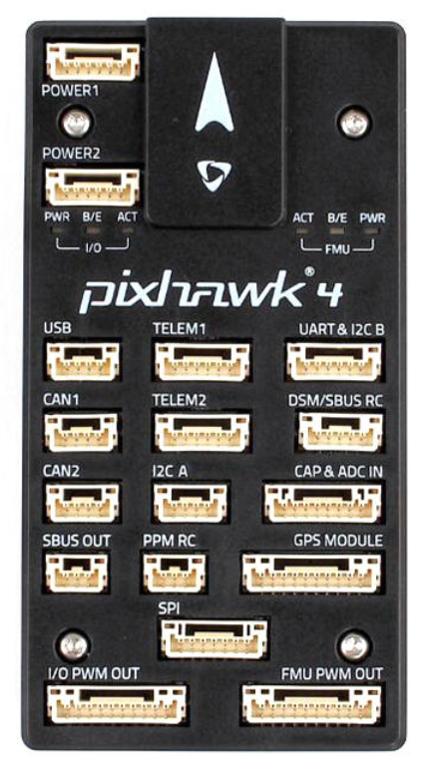
3s LiPo
Battery
Voltage
Regulator
5 V
Water
Servo
Telemetry
Radio
Habitat
Servo
CDA
Servo
Ch8 Ch7 Ch6 Ch5
PWM
Out
PPM
Encoder
Receiver
Ch1
Ch2
Ch3
Ch4
+
-
Ch1
Ch2
Ch3
Ch4
+
-
Ch1 Ch2 Ch3 Ch4
Aileron
Elevator
GPS
Throttle
Rudder

Slide 2
3s LiPo
Battery
Voltage
Regulator
FPV
Transmitter
FPV
Camera
11.1 V
5 V
Water
Servo
Telemetry
Radio
Habitat
Servo
CDA
Servo
Ch8 Ch7 Ch6 Ch5
PWM
Out
PPM
Encoder
Receiver
Ch1
Ch2
Ch3
Ch4
+
-
Ch1
Ch2
Ch3
Ch4
+
-
Ch1 Ch2 Ch3 Ch4
Aileron
Elevator
GPS
Throttle
Rudder

Slide 3
Telemetry
Radio
Laptop
11.1 V
3s LiPo
Battery
FPV
Receiver
VC 500 USB Image Capture

Slide 4
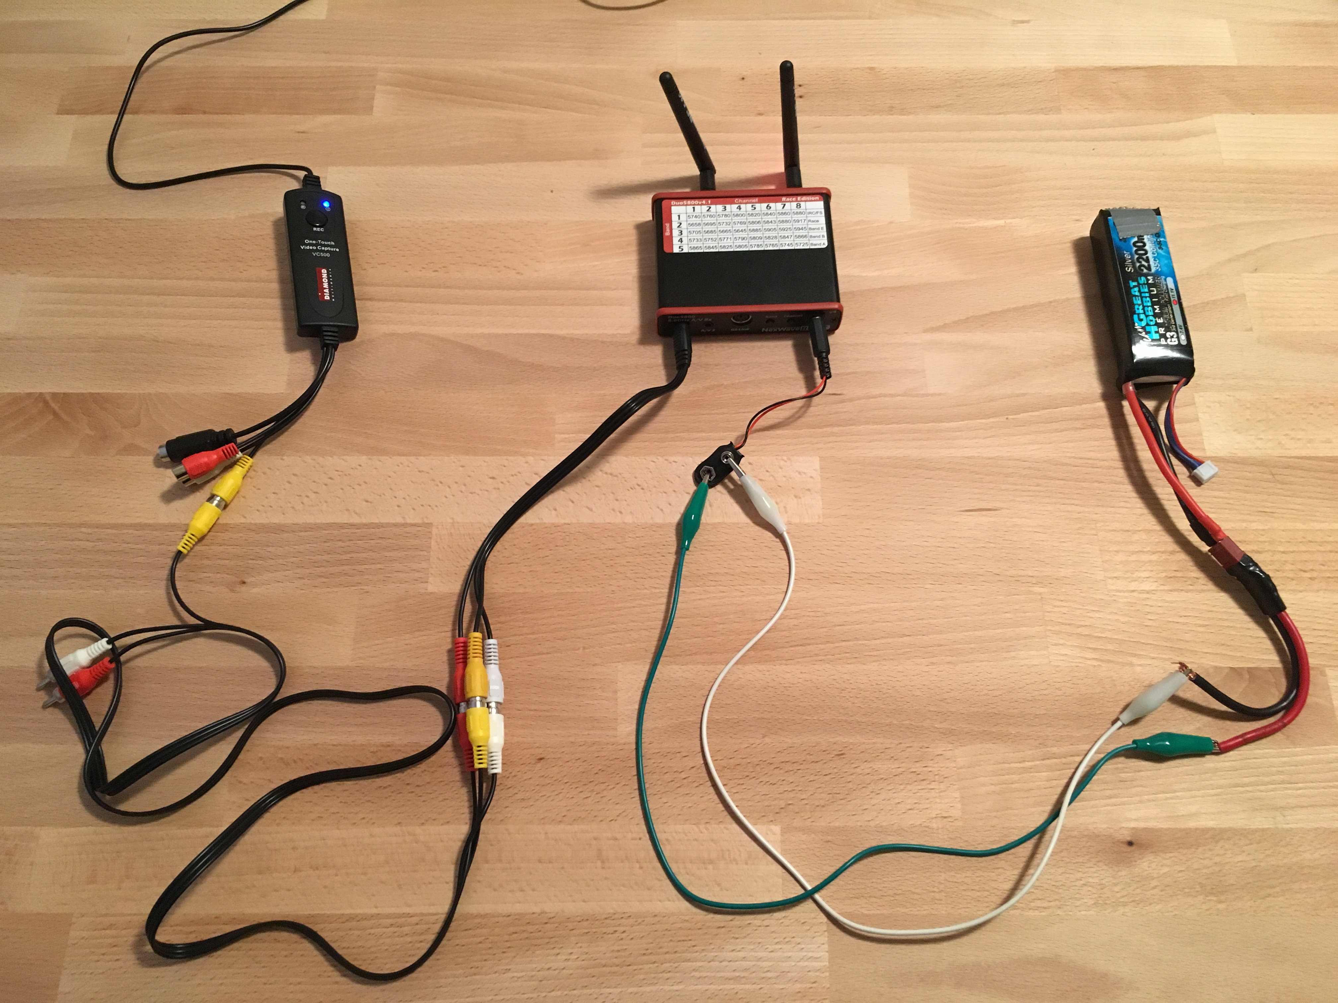
Laptop
11.1 V
3s LiPo
Battery
FPV
Receiver
VC 500 USB Image Capture

Slide 5
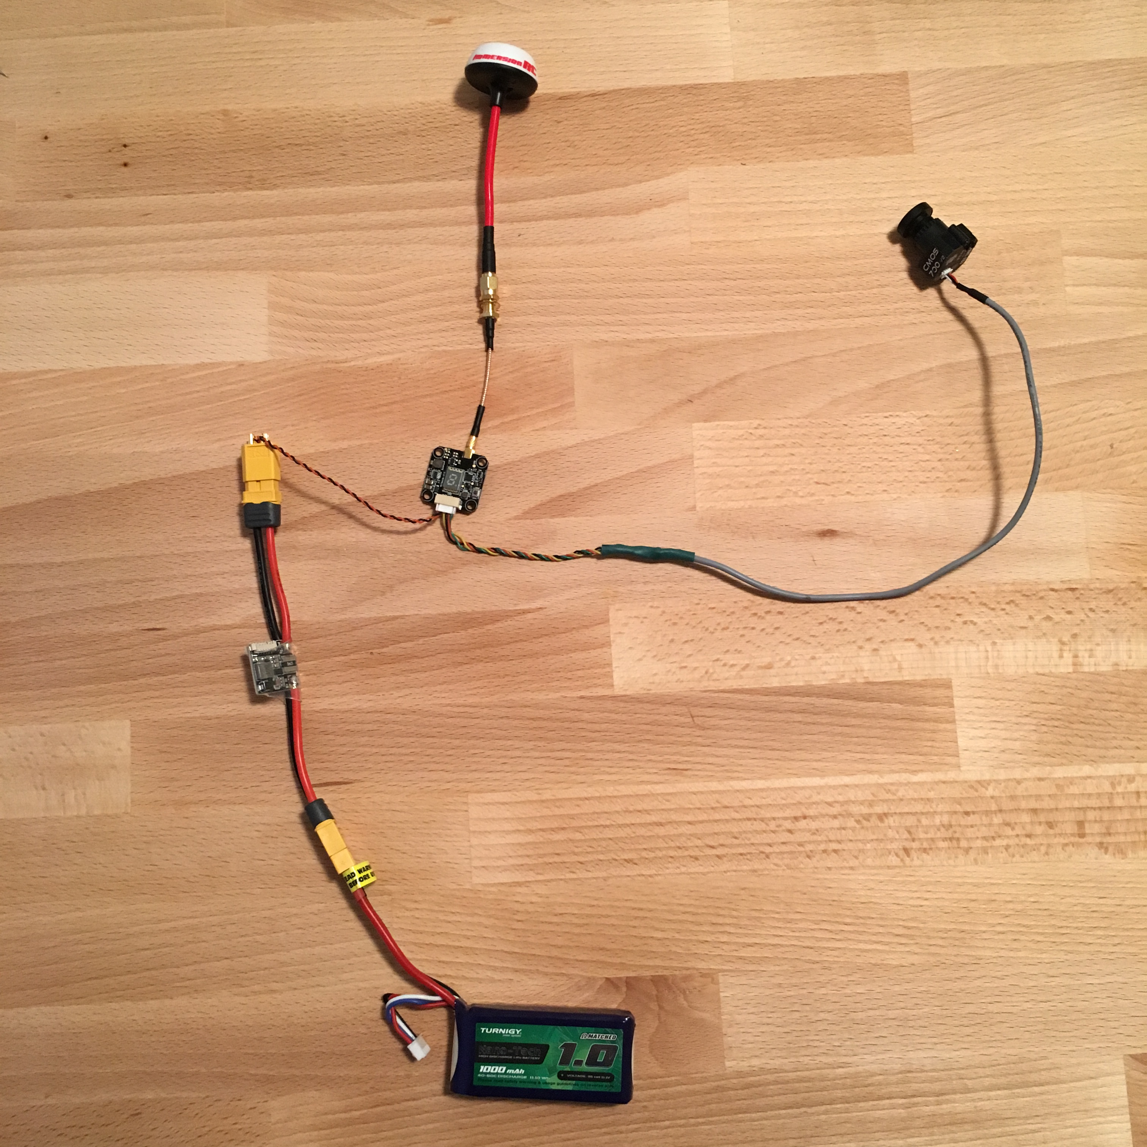
11.1 V
5 V
3s LiPo
Battery
FPV
Transmitter
FPV
Camera

